Slide 1
Mutation and Polymorphism
Locus (Loci)
Allele
Wild-type allele (most common, not exclusively normal)
Variant (mutant) allele
Mutation
Polymorphism
One way of classifying mutations is by size:
Chromosome mutations
Regional or subchromosomal mutations
Gene or DNA mutations

Slide 2
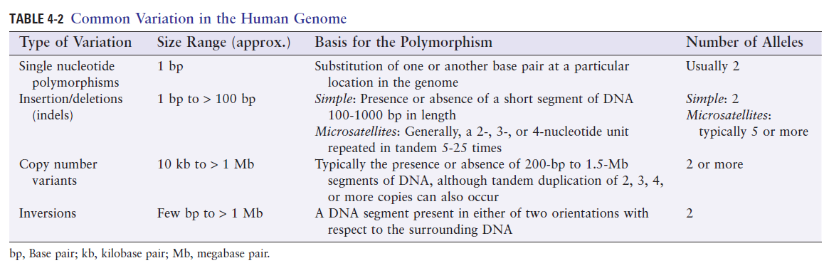

Slide 3
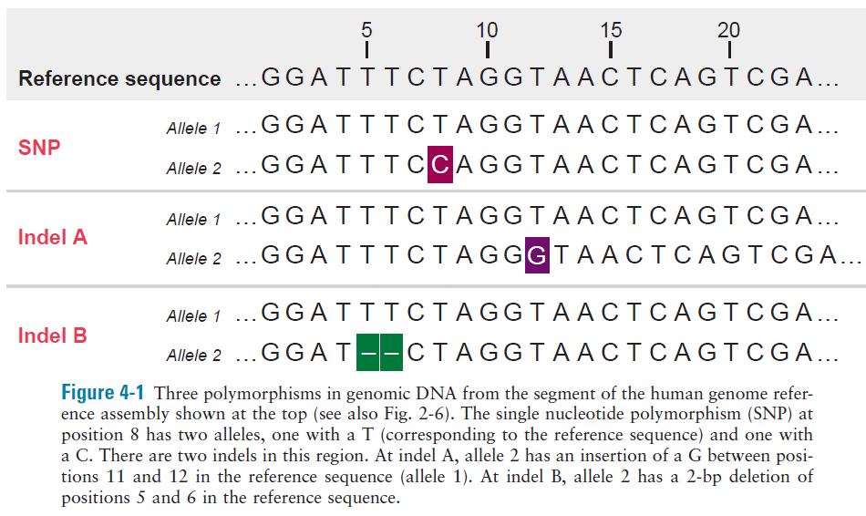

Slide 4
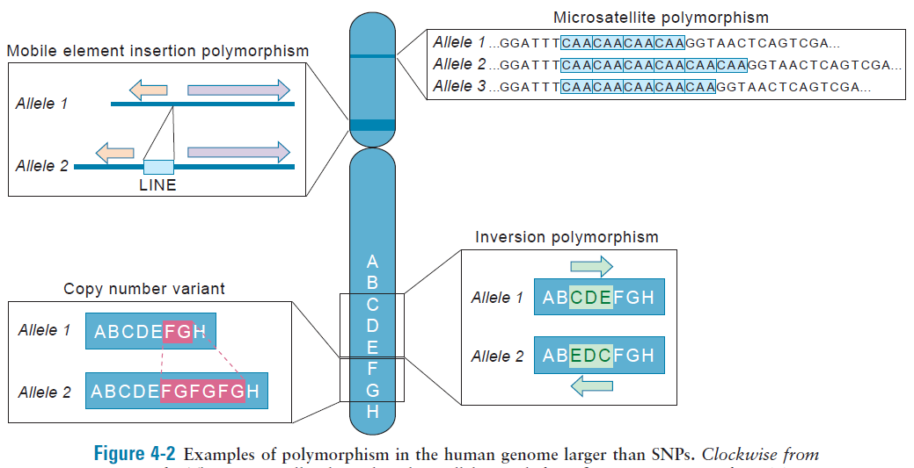

Slide 5
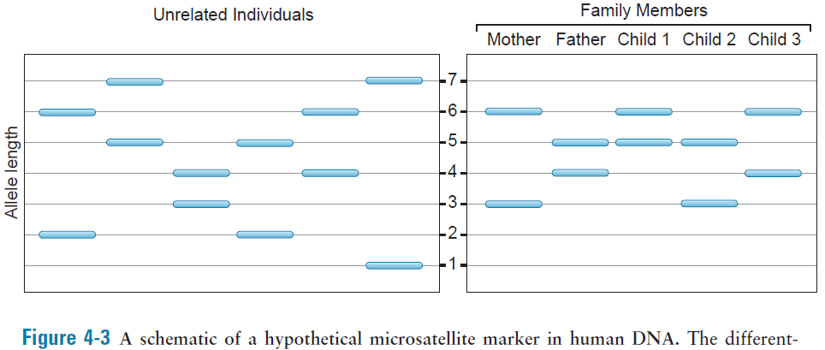
DNA fingerprinting
FBI’s CODIS (Combined DNA Index System) – 13 loci

Slide 6
Mobile element insertion polymorphisms
Retrotransposition
Alu and LINE families of repeats

Slide 7
Germline mutations
Somatic mutations
Cancer
Chromosome mutations
Missegregation, one per 25-50 meiotic cell divisions, underestimation because of spontaneous abortion
Regional mutations
Homologous recombination (Del, Dup, Inv)
Non-homologous end-joining repair (Trans, Inv)

Slide 8
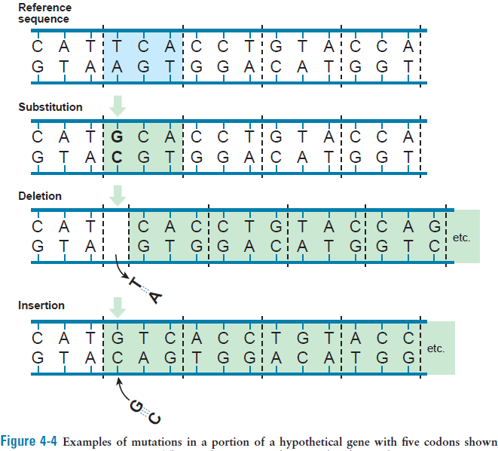
Gene mutations
DNA replication errors
DNA repair errors

Slide 9
DNA replication errors
DNA polymerase introduce 1 error every 1*10⁷ bp
Proofreading corrects more than 99.9% (1 in every 1*10³)
Overall replication mutation rate 1*10⁻¹⁰ per base per cell division
fewer than one mutation per genome per cell division
Repair of DNA damage
Chemical mutagens (natural or otherwise), UV, and ionizing radiation may cause deamination, demethylation, or depurination of bases
A very common spontaneous mutation is C>T (deamination of methyl cytosine results in thymine)

Slide 10
Rate of DNA mutations can be determined directly by whole genome sequencing of trios
Overall rate of new mutations averaged between maternal and paternal gametes is 1.2*10⁻⁸ mutations per base pair per generation
Every person is expected to receive ~75 new mutations from one or the other parent
One direct way to estimate rate of disease-causing mutations per locus per generation is to measure new incidence of new cases of genetic disease not present in either parent
In achondroplasia 7 patients were born in a series of 242,257 consecutive births. Thus new mutation rate is 1.4*10⁻⁵ disease causing mutations per locus per generation

Slide 11
The median gene mutation rate ~1*10⁻⁶
At least 5000 genes in human genome in which mutations cause disease
Thus, ~1 in 200 persons is likely to receive a new mutation in a known disease-associated gene from one or the other parent
Sex differences and age effects on mutation rates

Slide 12
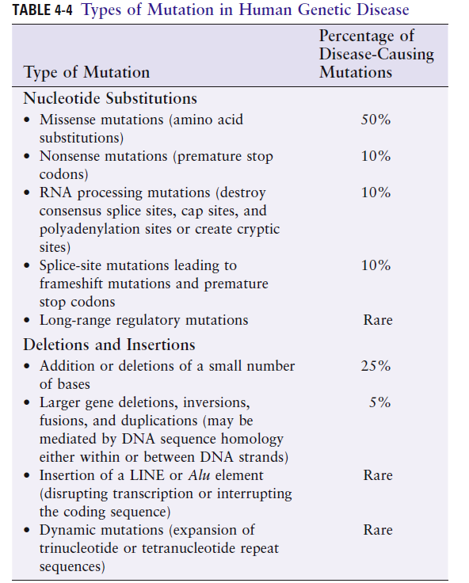

Slide 13
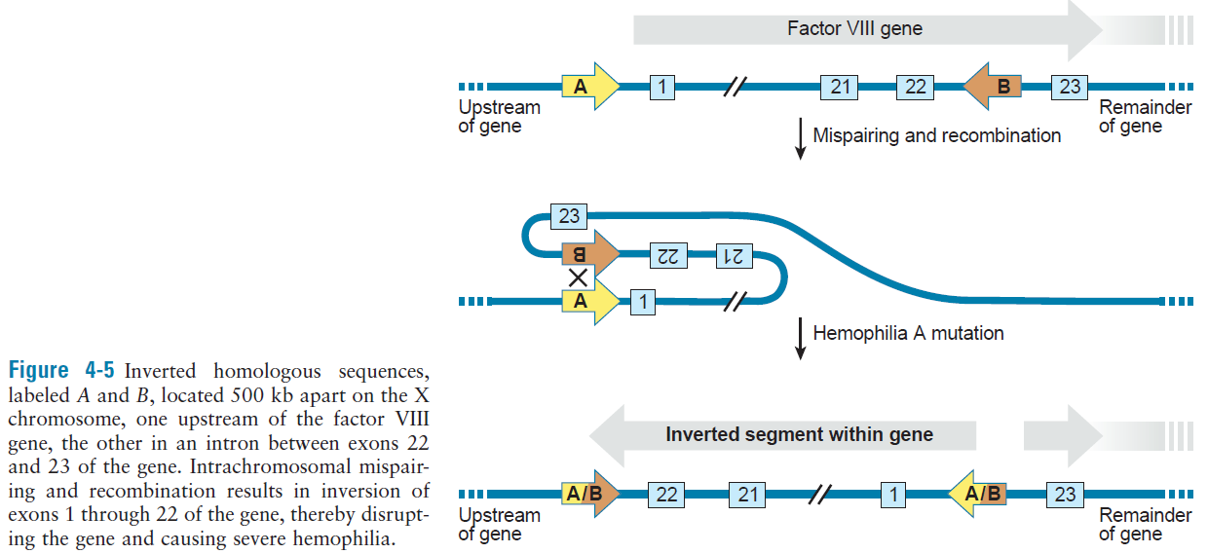

Slide 14
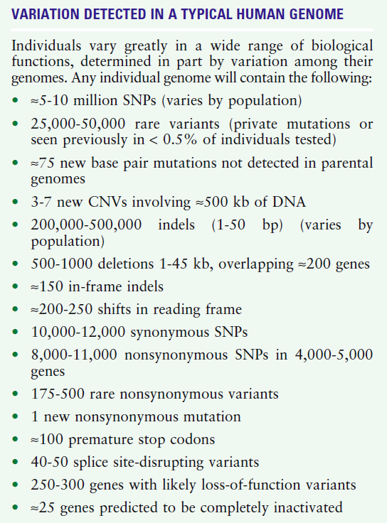
Whole genome sequencing
Whole exome sequencing
Implications for interpreting genome sequence data for patients

